Slide 1
Muscle to Meat Conversion
Meats unit

Slide 2
Muscle
Muscle must convert from its ___ function of movement to its use as food
Living tissue has an effect on meat quality

Slide 3
Muscle
Muscles function efficiently within a narrow range of physiological conditions
pH is --- =7
-----
-----

Slide 4
Homeostasis
Maintenance of a narrow range of physiological conditions where tissue functions efficiently.
Regulation of homeostasis gives muscle the ability to function under -----

Slide 5
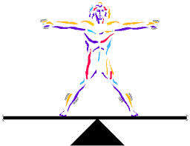
Homeostasis
Regulated by 2 body systems
------- system
-------- system
Loss of --------- is necessary to convert muscle into meat

Slide 6
Immobilization
To render unconscious
Effects of Homeostasis
Elevated blood pressure
Nerve stimulation

Slide 7
Exsanguination
Bleeding out, causing a loss of the circulatory system
Effects on Homeostasis
Severe compromise of homeostasis
Severe drop in blood pressure: how hard the blood is being pushed through the body
Heart pumps faster
Peripheral blood vessels constrict and force blood to the vital organs
Only 50% of blood is removed from carcass

Slide 8
Exsanguination
Results of loss of ------ system
Nutrients cannot be transported to the muscle
Waste products cannot be transported away.

Slide 9
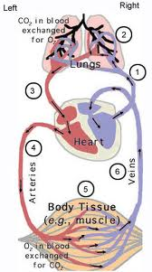
Effect on Metabolism
Metabolism is chemical transformations occurring within the cell
There are two types of metabolism,
Aerobic
Anerobic
Aerobic metabolism requires
oxygen. When the stored oxygen is
depleted, aerobic metabolism
cannot occur
Respiratory system is
eliminated
Muscle switches to ------ metabolism

Slide 10
Anaerobic Metabolism
Metabolism without oxygen- uses glycogen as energy source
Glycogen is the storage form of glucose
---------------- up in
the --------- over time
under normal conditions

Slide 11
Anaerobic Metabolism
Heat is produced
Body temperature actually ------ during harvest and then begins to -----
Build up of Lactic acid -product of anaerobic metabolism which drops the pH

Slide 12
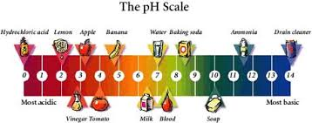
Lactic Acid
PH: measurement of how acidic or basic something is
Living Muscle – pH of 7.4
Meat – pH of 5.6
Quality problems with pH
Dark cutter – Beef
PSE (Pale Soft Exudative) - Swine

Slide 13
Rigor Mortis
Stiffening of the muscle after death
Permanent cross bridge formation between actin and myosin
Four Phases

Slide 14
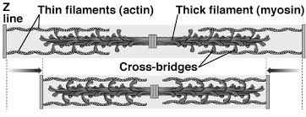
Rigor Mortis
1) ------: energy available so muscle can stretch when load is applied
2) -----: begin to lose its ability to stretch, some permanent cross bridges are formed- 2hours postmortem

Slide 15
Rigor Mortis
3 )-------: No ability to stretch, all permanent cross bridges
4) Resolution- Final step of rigor mortis
Break down of proteins by enzymes
Aging
Not breaking the cross bridges

Slide 16
Temperature and pH
Relationship is critical for development of good quality meat
________________________________

Slide 17
Stress
Two types
Acute Stress-one time or short term stress
Chronic Stress-long term continuous stress

Slide 18
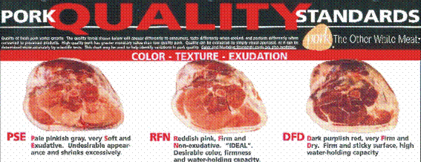
PSE
Pale Soft Exudative
Caused by acute stress prior to harvest

Slide 19
PSE
Stress prior to slaughter results in:
Increased _____________________
Rapid ____________ _______________
Build up of lactic acid

Slide 20
PSE
After harvest
--------------and -------------rapidly.
Rapid decline of pH at high temperatures cause proteins to denature or break down.

Slide 21
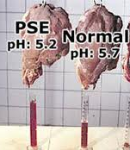
PSE
Pale- --------------------------------------------------------------------------------
Soft- ------------------------
Exudative---------------------------------------------------------------------

Slide 22
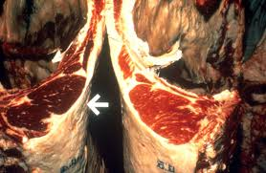
Dark Cutter
Makes meat dark,
firm, and dry
Results from
chronic stress
Chronic stress depletes muscle glycogen
If there is no glycogen built up in the cells before harvest there is no fuel for anaerobic metabolism

Slide 23
Dark Cutter
If anaerobic metabolism is limited there is little to no ----------produced
If lactic acid is limited the ----- of the muscle does not decline
Higher ---- makes for a more favorable environment for bacterial growth.

